Slide 1


Slide 2




Slide 3



MULTITHREADING
IN
JAVA

Slide 4
Multithreading in java
What are Threads in java
A thread is a light-weight smallest part of a process that can run concurrently with the other parts(other threads) of the same process
Threads are independent
They all have separate path of execution that’s the reason if an exception occurs in one thread

Slide 5
PROCESS
A process has a self-contained execution environment
A process generally has a complete, private set of basic run-time resources; in particular, each process has its own memory space
Processes are often seen as synonymous with programs or applications
However, what the user sees as a single application may in fact be a set of cooperating processes

Slide 6
PROCESS
To facilitate communication between processes, most operating systems support Inter Process Communication (IPC) resources, such as pipes and sockets
Exception
An exception is an unwanted or unexpected event, which occurs during the execution of a program i.e at run time, that disrupts the normal flow of the program’s instructions

Slide 7
Multithreading in java
The process of executing multiple threads simultaneously is known as multithreading
The main purpose of multithreading is to provide simultaneous execution of two or more parts of a program to maximum utilize the CPU time
A multithreaded program contains two or more parts that can run concurrently
Each such part of a program called thread

Slide 8
MULTI THREADING IN JAVA
Threads are lightweight sub-processes, they share the common memory space.
In Multithreaded environment, programs that are benefited from multithreading, utilize the maximum CPU time so that the idle time can be kept to minimum

Slide 9
THREAD STATES
NEW – A thread that has not yet started is in this state
RUNNABLE – A thread executing in the Java virtual machine is in this state
BLOCKED – A thread that is blocked waiting for a monitor lock is in this state
Note: A thread can be in only one state at a given point in time

Slide 10
MULTI THREADING IN JAVA
WAITING – A thread that is waiting indefinitely for another thread to perform a particular action is in this state
TIMED_WAITING – A thread that is waiting for another thread to perform an action for up to a specified waiting time is in this state
TERMINATED – A thread that has exited is in this state

Slide 11
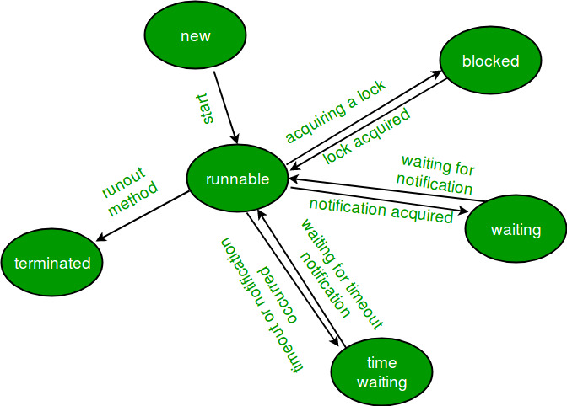
LIFE CYCLE OF THREADS

Slide 12
MULTITASKING VS MULTITHREADING VS MULTIPROCESSING VS PARALLEL PROCESSING
Multitasking: Ability to execute more than one task at the same time is known as multitasking
Multithreading: It is a process of executing multiple threads simultaneously
Multithreading is also known as Thread-based Multitasking

Slide 13
MULTITASKING VS MULTITHREADING VS MULTIPROCESSING VS PARALLEL PROCESSING
Multiprocessing: It is same as multitasking, however in multiprocessing more than one CPUs are involved
On the other hand one CPU is involved in multitasking
Parallel Processing: It refers to the utilization of multiple CPUs in a single computer system

Slide 14
CREATING A THREAD IN JAVA
There are two ways to create a thread in Java
By extending Thread class
By implementing Runnable interface

Slide 15
CREATING A THREAD IN JAVA
Before we begin with the programs(code) of creating threads, let’s have a look at these methods of Thread class. We have used few of these methods in the example below
getName(): It is used for Obtaining a thread’s name
getPriority(): Obtain a thread’s priority
isAlive(): Determine if a thread is still running
join(): Wait for a thread to terminate

Slide 16
CREATING A THREAD IN JAVA
run(): Entry point for the thread
sleep(): suspend a thread for a period of time
start(): start a thread by calling its run() method

Slide 17
METHOD 1
Thread creation by extending Thread class
class MultithreadingDemo extends Thread{ public void run(){ System.out.println("My thread is in running state."); } public static void main(String args[]){ MultithreadingDemo obj=new MultithreadingDemo(); obj.start(); } }

Slide 18
METHOD 2
Thread creation by implementing Runnable Interface
class MultithreadingDemo implements Runnable{ public void run(){ System.out.println("My thread is in running state."); } public static void main(String args[]){ MultithreadingDemo obj=new MultithreadingDemo(); Thread tobj =new Thread(obj); tobj.start(); } }

Slide 19
Practice Program
class Count implements Runnable { Thread mythread ; Count() { mythread = new Thread(this, "my runnable thread"); System.out.println("my thread created" + mythread); mythread.start(); } public void run() { try { for (int i=0 ;i<10;i++) { System.out.println("Printing the count " + i); Thread.sleep(1000); } }

Slide 20
Practice Program
catch(InterruptedException e) { System.out.println("my thread interrupted"); } System.out.println("mythread run is over" ); } } class RunnableExample { public static void main(String args[]) { Count cnt = new Count(); try { while(cnt.mythread.isAlive()) { System.out.println("Main thread will be alive till the child thread is live"); Thread.sleep(1500); } }

Slide 21
Practice Program
catch(InterruptedException e) { System.out.println("Main thread interrupted"); } System.out.println("Main thread run is over" ); } }

Slide 22

THANK YOU

